Slide 1

CSE 111 Project:
NBA Stats Database
Christopher Tapia Henry Wang

Slide 2
System Description
We created a Python-based application designed for managing and analyzing basketball-related data, specifically the 2022 - 2023 NBA season.
It incorporates a SQLite database to store comprehensive data about players, games, coaches, teams, shots, and news, primarily focused on basketball.
The application is made for sports data management and analysis, offering insights into player performances and sports events.

Slide 3
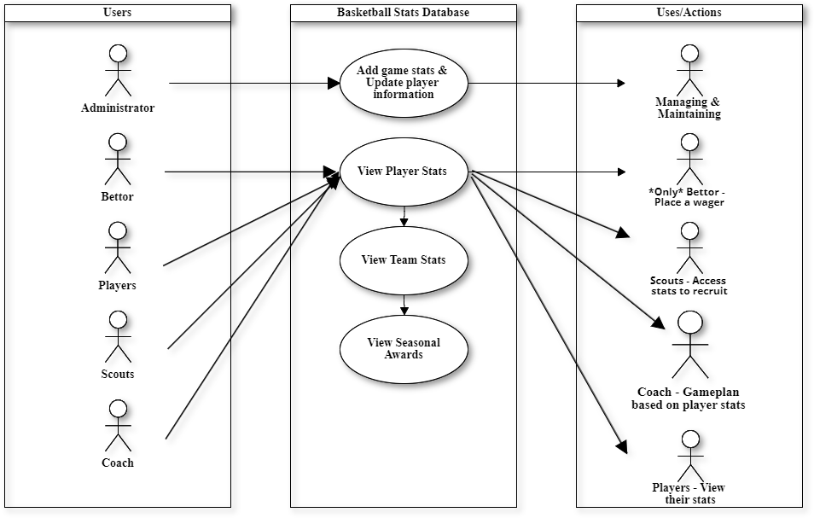
UML Use-Case Diagram
Main Use Cases:
Ourselves/Admins to manage and maintain the database
Bettor can place wagers based on player or team stats
Scouts can analyze players stats for recruitment
Coach can analyze a team & player stats to game plan
Players can look at their own stats to chase seasonal awards

Slide 4
Use-Case Description:
The key interactions between the user and the application include:
Viewing and Filtering News:
Users can view all news items or apply filters to view news by specific types or dates, providing customized access to sports-related news.
Analyzing Player and Team Statistics:
The application allows users to input a player's name and team to retrieve and analyze detailed statistics, such as average points, rebounds, assists, steals, and blocks per game.
User Interaction via Text-based Interface:
Users navigate through the application using a series of menu options and prompts in a command-line interface, making data access and analysis straightforward and efficient.

Slide 5
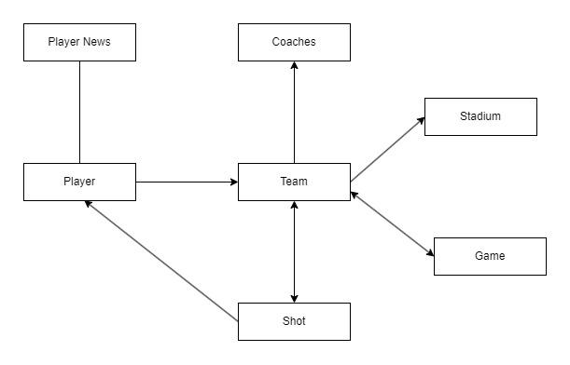
Entity/Relationship Diagram
Relation Types:
2 many to many relations
Team - Game
Team - Shot
2 one to one relations
Team - Coach
Team - Stadium
2 one to many relations
Team - Player
Player - Player News

Slide 6
Relational Schema
CREATE TABLE coaches (
c_coachid INTEGER PRIMARY KEY,
c_name varchar(50),
c_startyear date not null,
c_numofchamp int);
CREATE TABLE game (
g_gameid INTEGER PRIMARY KEY,
g_home INTEGER,
g_away INTEGER,
g_date TEXT,
g_winner INTEGER,
g_score TEXT,
g_stadium INTEGER);
CREATE TABLE news (
n_newsid INTEGER PRIMARY KEY,
n_type TEXT,
n_date TEXT,
n_news TEXT);
CREATE TABLE stadium (
st_stadiumid INTEGER PRIMARY KEY,
st_name varchar(50),
st_size int,
st_location varchar(50));
CREATE TABLE player (
p_playerid INTEGER PRIMARY KEY,
p_name TEXT,
p_teamname TEXT,
p_teamid INTEGER,
p_position INTEGER,
p_height REAL,
p_weight INTEGER,
p_ppg REAL,
p_rpg REAL,
p_apg REAL,
p_spg REAL,
p_bpg REAL,
p_FGpercent REAL,
p_3ppercent REAL,
p_startyear INTEGER,
p_salary INTEGER);
CREATE TABLE team (
t_teamid INTEGER PRIMARY KEY,
t_name varchar (50),
t_foundyear date NOT NULL,
t_city varchar (50),
t_coachid int,
t_stadiumid int);
CREATE TABLE shots (
s_playerid INTEGER REFERENCES Player (p_playerid),
s_playername TEXT,
s_teamid INTEGER REFERENCES Team (t_teamid),
s_FG REAL,
s_FGA REAL,
s_FGPCT REAL,
s_3P REAL,
s_3PA REAL,
s_3PPCT REAL,
s_2P REAL,
s_2PA REAL,
s_2PPCT REAL,
s_eFGPCT REAL,
s_FT REAL,
s_FTA REAL,
s_FTPCT REAL);

Slide 7
Implementation Details
Database:
SQLite, chosen for its lightweight and file-based nature, ideal for small-scale applications.
User Interface:
A simple, text-based command-line interface that facilitates user interaction through textual commands and choices.
Programming Language and Libraries:
Python, utilizing the sqlite3 module for database operations, which indicates a focus on simplicity and efficiency in development and deployment.
This system is particularly suited for sports analysts, team managers, or basketball enthusiasts who require a tool for detailed data-driven analysis and management of basketball statistics.

